Slide 1
Hardware based Security mechanisms
Samuel OCEN
E MAIL: - samuel.ocen@mmu.ac.ug
samuel.ocen@student.uonbi.ac.ke
MOB: - +256(0)775 679 505
+256(0)706 109 393

Slide 2
Physical Security
Physical security is the protection of personnel, hardware, software, networks and data from physical actions and events that could cause serious loss or damage to an enterprise, agency or institution.
This includes protection from fire, flood, natural disasters, burglary, theft, vandalism and terrorism. While most of these are covered by insurance, physical security's prioritization of damage prevention avoids the time, money and resources lost because of these events.

Slide 3
Physical Security Framework
Access Control
The key to maximizing one's physical security measures is to limit and control what people have access to sites, facilities and materials. Access control encompasses the measures taken to limit exposure of certain assets to authorized personnel only. Examples of these corporate barriers often include ID badges, keypads and security guards.
Surveillance
This is one of the most important physical security components for both prevention and post-incident recovery. Surveillance, in this case, refers to the technology, personnel and resources that organizations use to monitor the activity of different real-world locations and facilities. These examples can include patrol guards, heat sensors and notification systems.

Slide 4
Physical Security Framework Continued.
Testing
Physical security is a preventative measure and incident response tool. Disaster recovery (DR) plans, for example, center on the quality of one's physical security protocols -- how well a company identifies, responds to and contains a threat.
The success of an organization's physical security program can often be attributed to how well each of these components is implemented, improved and maintained.

Slide 5
Physical Security Examples
Log and trail maintenance
Keeping a record of what is accessed -- and what people attempt to access -- is a reliable way to not only discourage unauthorized users, but create a forensic-friendly data environment.
Risk-based approach
One of the most effective ways to optimize a physical security investment is to use a risk-based approach. This is a data analysis technique used to evaluate scenarios based on one's risk profile

Slide 6
Physical Security Examples
Accountable access control
By tying access control to individuals, an organization can improve its visibility over personnel activity.

Slide 7
Authentication
The process of verifying the identity of a user, process, or device, often as a prerequisite to allowing access to resources in an information system.
There are three basic types of authentication.
Knowledge-based — something like a password or PIN code that only the identified user would know.
Property-based, meaning the user possesses an access card, key, key fob or authorized device unique to them.
Biologically based.

Slide 8
Authentication Methods
Token Authentication
Passwords
Behavior Biometrics
Multi-Factor Authentication
Single Sign-On
Certificate-based authentication

Slide 9
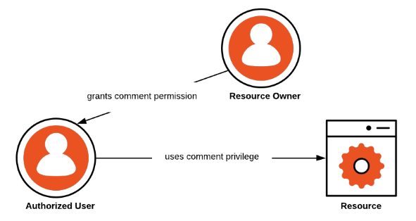
Authorization
Authorization is a process by which a server determines if the client has permission to use a resource or access a file.
Any authorization platform must be An easy to implement, adaptable authentication and authorization platform
Authoriz
ation Use Case

Slide 10
Authorization strategies during application deployment.
Attribute-Based Access Control (ABAC) and Authorization
When using ABAC, a computer system defines whether a user has sufficient access privileges to execute an action based on a trait (attribute or claim) associated with that user.
Role-Based Access Control (RBAC) and Authorization.
RBAC, on the other hand, treats authorization as permissions associated with roles and not directly with users. A role is nothing but a collection of permissions. For example, imagine that you work as a department manager in an organization. In this situation, you should have permissions that reflect your role, for example, the ability to approve vacation requests and expense requests, assign tasks, and so on.
Relationship-Based Access Control (ReBAC) and Authorization
This examines if the user has sufficient relationship to this object or action such that they can access it?

Slide 11
Questions
1. What reasons would you use authorization to control a computer resource? (select all that apply)
a) To lock access to a computer altogether
b) To prevent users from accessing specific resources
c) To improve overall computer security
2. Which authorization strategy allows you to create collections of permissions that can be easily assigned or removed to a user all at once?
RBAC
GBAC
ABAC

Slide 12
Accounting
Accounting, also known as auditing, is the process of keeping track of a user's activity while accessing the network resources, including the amount of time spent in the network, the services accessed while there, and the amount of data transferred during the session.
This can include the amount of system time or the amount of data sent and received during a session. Accounting is carried out by logging session statistics and usage information.
It’s the last stage in the AAA framework

Slide 13
Advantages of Accounting as a Computer Security Framework
Reduce the possibility of fraud and errors.
Improve efficiency in business operations.
Find out the loopholes in the system.
Identify risky areas in the system security, so management can do their planning before any incident.
Checks susceptibility to threat
Evaluating the System
Data Security.
Bolsters Controls
Develops IT Governance

Slide 14
Data Encryption
Data encryption is a security method where information is encoded and can only be accessed or decrypted by a user with the correct encryption key.
Encrypted data, also known as ciphertext, appears scrambled or unreadable to a person or entity accessing without permission.

Slide 15
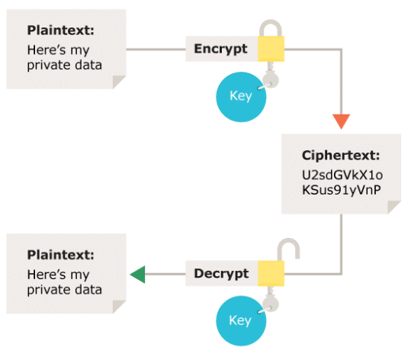
Data Encryption Types
Symmetric encryption

Slide 16
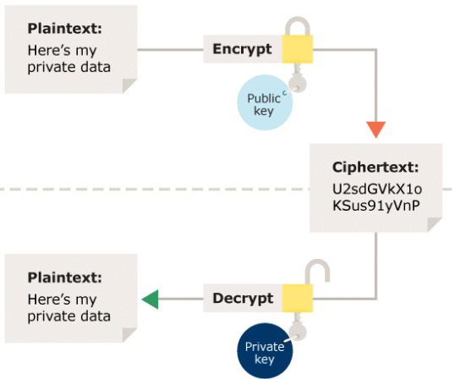
Data Encryption Types
Asymmetric encryption.

Slide 17
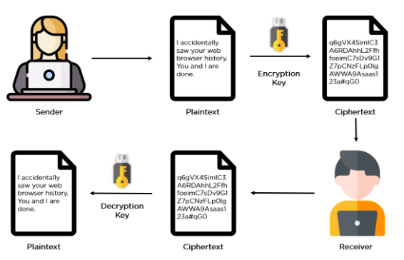
How data Encryption Works

Slide 18
Methods of Encryption
AES. The Advanced Encryption Standard (AES) is the trusted standard algorithm used by the United States government, as well as other organizations. Although extremely efficient in the 128-bit form, AES also uses 192- and 256-bit keys for very demanding encryption purposes. AES is widely considered invulnerable to all attacks except for brute force. Regardless, many internet security experts believe AES will eventually be regarded as the go-to standard for encrypting data in the private sector.
Triple DES. Triple DES is the successor to the original Data Encryption Standard (DES) algorithm, created in response to hackers who figured out how to breach DES. It’s symmetric encryption that was once the most widely used symmetric algorithm in the industry, though it’s being gradually phased out. TripleDES applies the DES algorithm three times to every data block and is commonly used to encrypt UNIX passwords and ATM PINs.
RSA. RSA is a public-key encryption asymmetric algorithm and the standard for encrypting information transmitted via the internet. RSA encryption is robust and reliable because it creates a massive bunch of gibberish that frustrates would-be hackers, causing them to expend a lot of time and energy to crack into systems.

Slide 19
Methods of Encryption
Blowfish. Blowfish is another algorithm that was designed to replace DES. This symmetric tool breaks messages into 64-bit blocks and encrypts them individually. Blowfish has established a reputation for speed, flexibility, and is unbreakable. It’s in the public domain, so that makes it free, adding even more to its appeal. Blowfish is commonly found on e-commerce platforms, securing payments, and in password management tools.
Twofish. Twofish is Blowfish’s successor. It’s license-free, symmetric encryption that deciphers 128-bit data blocks. Additionally, Twofish always encrypts data in 16 rounds, no matter what the key size. Twofish is perfect for both software and hardware environments and is considered one of the fastest of its type. Many of today’s file and folder encryption software solutions use this method.
Rivest-Shamir-Adleman (RSA). Rivest-Shamir-Adleman is an asymmetric encryption algorithm that works off the factorization of the product of two large prime numbers. Only a user with knowledge of these two numbers can decode the message successfully. Digital signatures commonly use RSA, but the algorithm slows down when it encrypts large volumes of data.

Slide 20
Packet filters

